Slide 1

Artificial Analyst
Dan Cannon & Neya Johnson

Slide 2

Our Approach & Goal
Amass data on stocks in the tech sector and specifically the semiconductor sector.
Perform an analysis on metrics like RSI [Relative Strength Index] to make a recommendation on the stock.
Use historical price and volume data to predict the likelihood that a stock will have a stock split.
Predicting Earnings Trade Action.

Slide 3
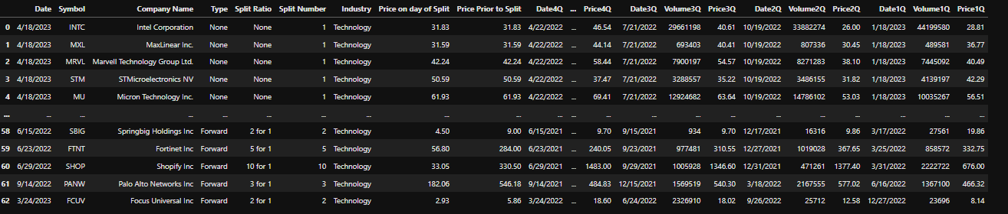
Our Data – Stock Splits

Slide 4

Our Approach
Encode the data
Based upon no split vs a forward split
Train test split
Scale Data
Logistic Regression model

Slide 5
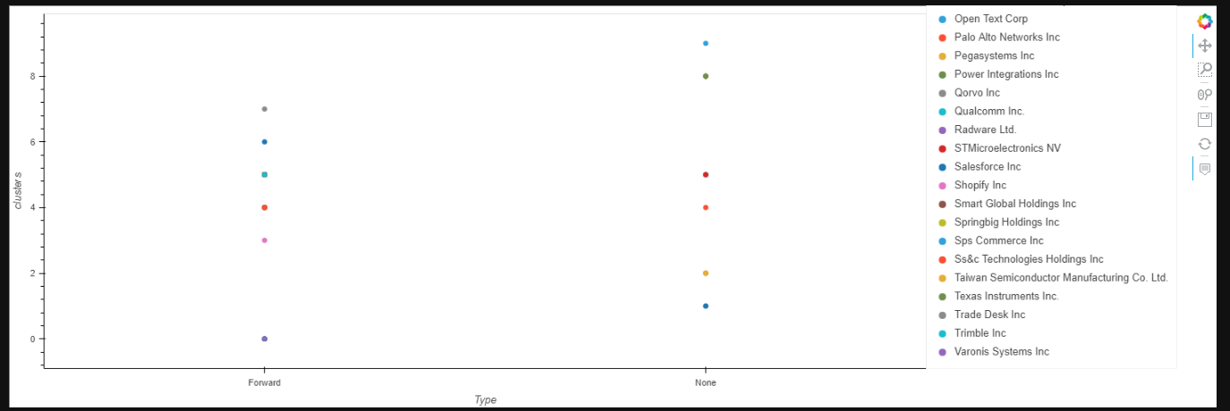
Our Approach part 2
K Means Clustering

Slide 6
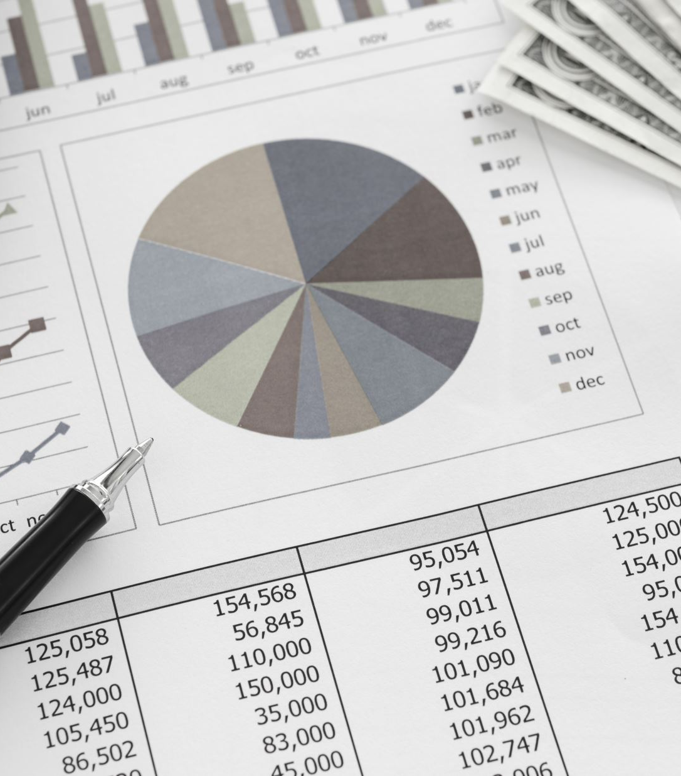
Next Steps
Things we would do with more time:
Include stock split data for reverse splits as well as forward splits
Seek out many sources of split data to ensure validity and accuracy
Take historical data for longer than 1 year into account
Chart Keltner Channels over the Bollinger Bands

